Slide 1


Customer Segmentation and Understanding the Sales Patterns in an E-Commerce Dataset.
Presented By
Rajesh kumar kinjarapu
12211048
k22ug

Slide 2
TABLE OF CONTENTS
S.No | Contents | Page No.
I. | Introduction of project | 3
II. | Problem Statement | 4
III. | Methodology | 5-6
IV. | Result | 7
V. | Analysis | 8-10
VI. | Conclusion | 11
VII. | References | 12

Slide 3
1.Introduction
Understanding customer behavior and sales patterns is essential for developing effective business strategies in e-commerce. This project focuses on analyzing a dataset containing attributes such as Sales, Quantity, Profit, Discount, and categorical features like Segment, Ship Mode, and Region. The data also includes customer-specific attributes and product-level details, providing a comprehensive view of the factors influencing sales performance and customer segmentation. Through exploratory data analysis (EDA) and clustering techniques, the project uncovers trends, patterns, and relationships, offering actionable insights to support strategic decision-making, optimize marketing efforts, and enhance customer engagement.

Slide 4
2.Problem Statement
The objective of this project is to analyze customer behavior and sales patterns in an e-commerce dataset to uncover actionable insights that drive business growth. By segmenting customers based on their purchasing behavior and analyzing factors such as Sales, Profit, Quantity, and Discounts, the study aims to identify distinct customer groups, evaluate their characteristics, and understand regional and product-based performance. The findings will help in optimizing marketing strategies, improving customer targeting, and enhancing overall profitability, providing a data-driven foundation for informed decision-making.

Slide 5
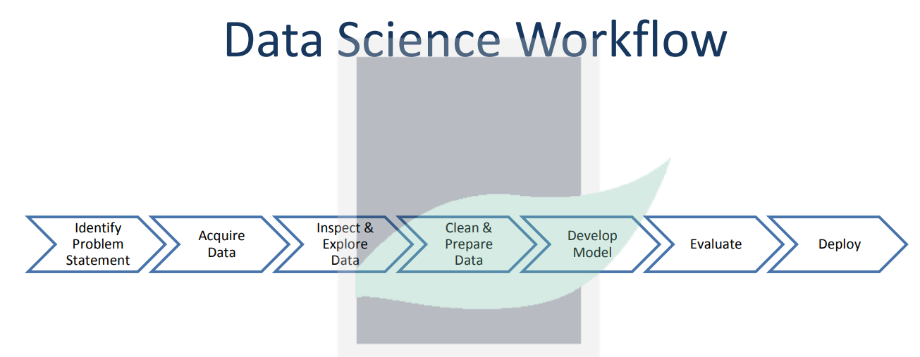
3.Methodology:
Data Collection & Inspection
Acquire e-commerce dataset (Sales, Quantity, Profit, Discount, etc.).
Inspect data for inconsistencies, missing values, and outliers, Duplicates, Irrelevant Columns.
Data Preprocessing
Handle missing data with Imputation, dropping rows and Columns and outliers.
Changed the Format of inconsistent data Formats and Duplicates.
Feature Engineering
Create new features (e.g., Customer Lifetime Value, Recency, Frequency, and Monetary ).
Transform categorical data into numerical representations (e.g., One-hot encoding).

Slide 6
Methodology:
4.Feature Scaling
Standardize features (Sales, Quantity, Profit, Discount) using Standard Scaler to make them comparable for clustering.
5. Data Visualization
Univariate Analysis: Visualize distributions of individual variables (Histograms, Box Plots, Violin Plots, Bar Charts, Pie Charts).
Bivariate Analysis: Analyze relationships between two variables (scatter plots, correlation plots).
Multivariate Analysis: Use pair plots, 3D plots, or heatmaps to analyze interactions between multiple features.
6.Customer Segmentation
Apply K-Means Clustering to segment customers into distinct groups based on purchasing behavior.
Use the Elbow Method to determine the optimal number of clusters.
Apply PCA (Principal Component Analysis) for dimensionality reduction and visualization.

Slide 7
4.Result
High-Value Customers: Identified customers with high sales and profit, suggesting they are prime targets for loyalty programs.(Cluster 0 and Cluster 2)
At-Risk Customers: Found a segment with low sales and profit, suggesting they may need targeted marketing strategies or product recommendations.( Cluster 3 and Cluster 1)
Frequent Shoppers: A group purchasing in high quantities but with low sales value, indicating the potential for bundle offers or upselling.(Cluster 1)
Top Countries: California, New York, Texas are the countries with highest sales.
Top Products: Staple related products in the Home-office Segment.
Shipping Mode: Most preferred shipping mode is Standard Class.
Year: Year with highest sales is 2016

Slide 8
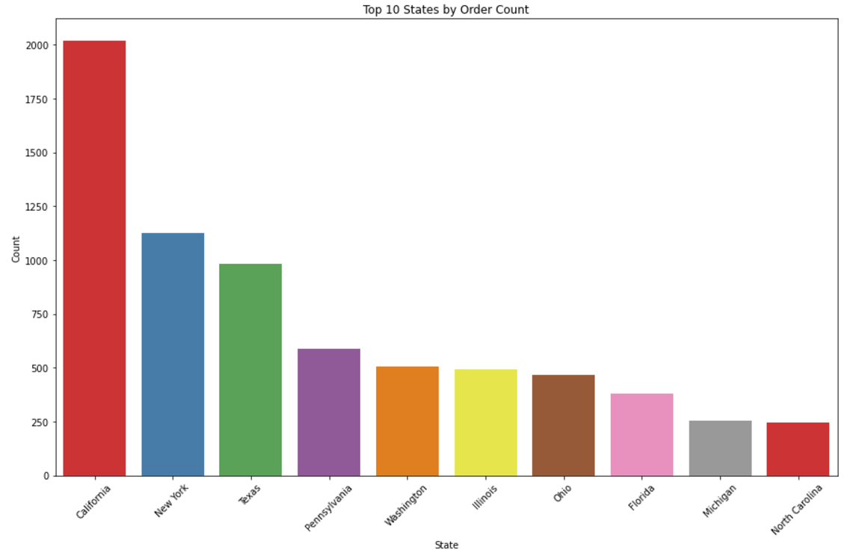
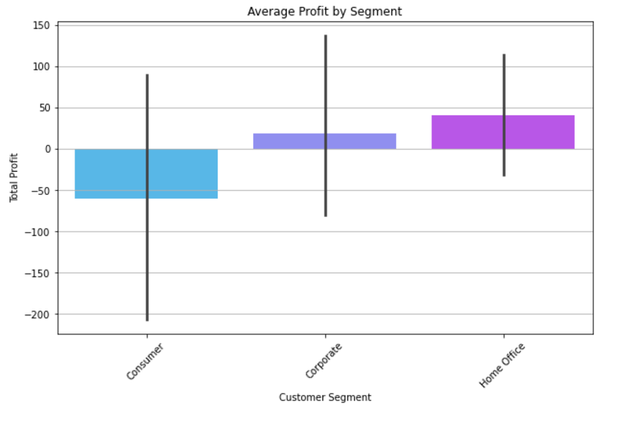
5.Analysis
Fig-1: 2D Bar Chart
Segment vs. Profit: To compare average profit across different customer segments.
Fig-2: Bar Chart
Gives Top 10states which generates highest Revenue of Sales with highest count of Orders.

Slide 9
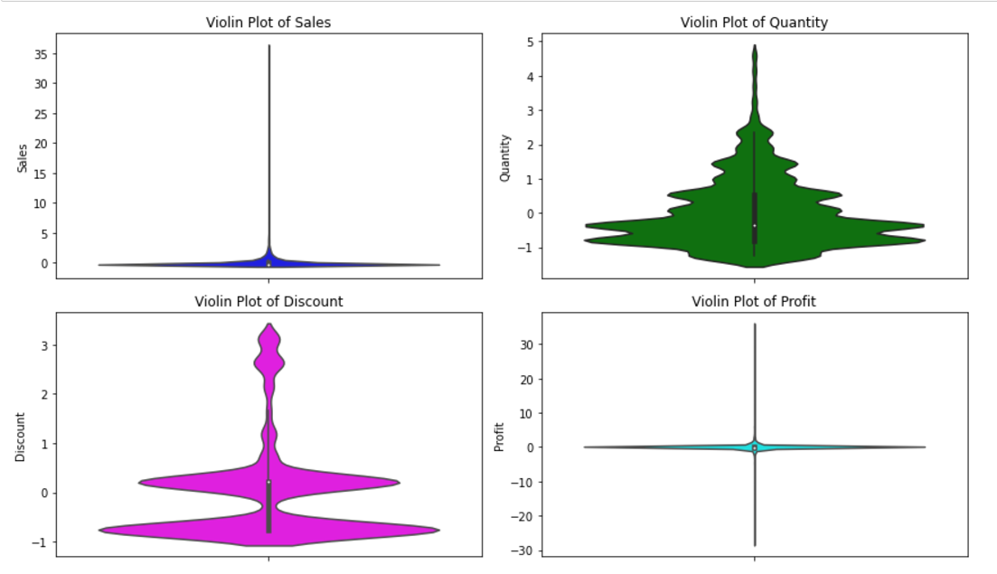
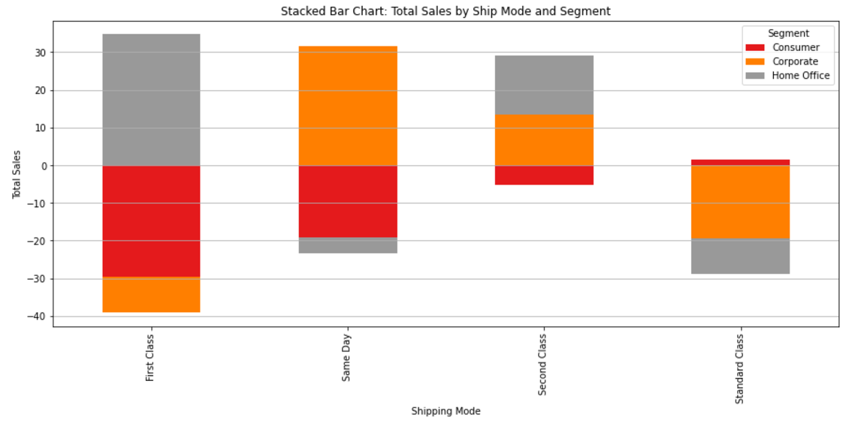
Fig-3 : Violin Plot
Combines the box plot and density plot, showing the distribution of the data and as well as outliers.
Fig-4: Stacked Bar Chart
Ship Mode vs. Profit: To see how Sales varies among different shipping methods and the contribution of each.

Slide 10
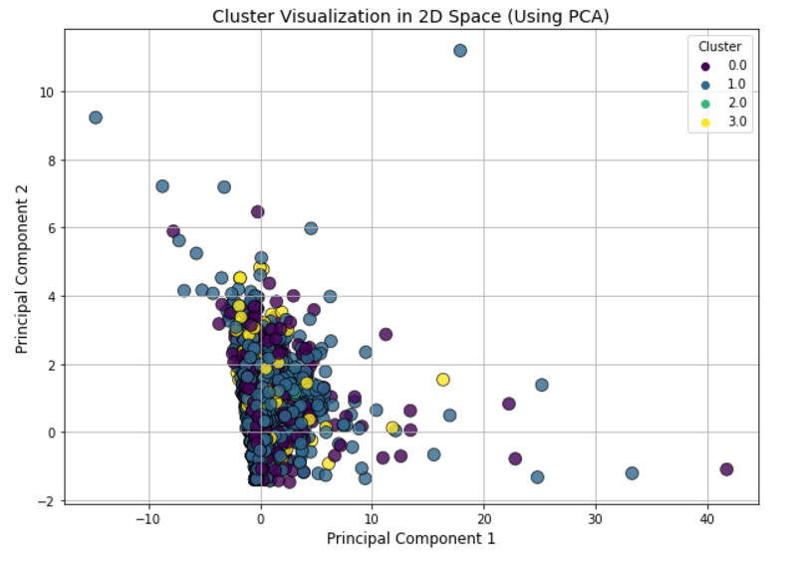
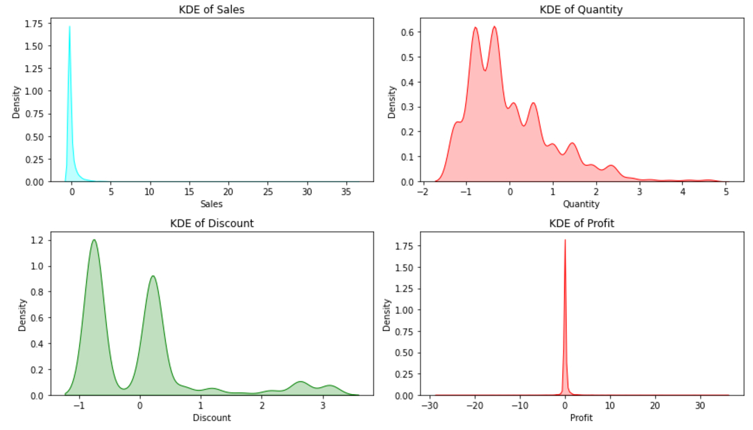
Pie Chart
Fig-5:PCA Cluster Visualization (2D)
The scatter plot displays customer clusters in 2D space after applying PCA. It helps identify customer groups with distinct purchasing and profit behaviors, simplifying complex data into interpretable patterns.
Fig-4:Kernel Density Estimation
Shows the distribution of data across a continuous range for features Sale, Quantity, Discount, Profit.

Slide 11
6.Conclusion
In this customer segmentation and sales pattern analysis project, we identified distinct customer segments based on key factors like sales, quantity, profit, and discount. Through the Elbow Method, we determined that four clusters were optimal for grouping customers, which were further validated through PCA for visualization. The analysis revealed that certain segments of customers have higher sales volumes, while others are more price-sensitive, focusing on discounts and quantity. By examining these segments, we gained insights into the different purchasing behaviors and preferences of customers. These findings can be used to tailor marketing strategies, optimize product offerings, and improve customer targeting, ultimately enhancing sales performance.

Slide 12
7.REFERENCE :
1. Kaggle - A platform for datasets and data science projects.
https://www.kaggle.com
2. Towards Data Science - Articles on data science techniques and tools.
https://towardsdatascience.com
3. Medium: Analytics Vidhya - Insights on data science, machine learning, AI.
https://medium.com/analytics-vidhya
4. Geeks for Geeks - Tutorials on data science, Python, and machine learning.
https://www.geeksforgeeks.org
5. Data Camp - Learn data science with online courses and projects.
https://www.datacamp.com
6. Coursera - Data science courses from top universities.
https://www.coursera.org
7. Statista - Insights and statistics for e-commerce trends.
https://www.statista.com
8. Stack Overflow - Community discussions on coding and data analysis.
https://stackoverflow.com
9. GitHub - A repository for data science projects and open-source code.
https://github.com
10. Investopedia - Insights into financial and sales data analysis.
https://www.investopedia.com

Slide 13


